Slide 1
Introduction to DjAngo
Rohan Patel

Slide 2
Topics to cover
Introduction
What is Web Application

Slide 3
Introduction
Django is a high-level Python framework. It is free, open-source and one of the most popular frameworks.
Django is popular among developers because of the vast amount to inbuilt features it provides such as admin interface, Object relational mapper for SQL and caching
Web Applications using Django – Netflix, YouTube, Uber, Spotify and NASA

Slide 4
Other Features of Django
Secure
Scalable
Rapid Development
Vast and Supported Community

Slide 5
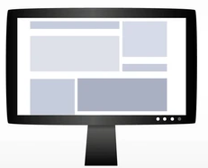
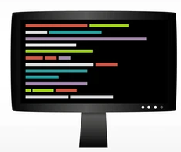
What is Web Application
In Basic Terms a web application is made up of two part a front end and a back end
Request
Response

Slide 6
Different types of

